Slide 1
Computer Architecture Experiment
Topic 5. Pipelined CPU supporting
31 MIPS Instructions
浙江大学计算机学院
陈文智
chenwz@zju.edu.cn

Slide 2
实验操作流程
阅读实验文档，理解31条MIPS指令实现方式
以前一次实验为基础，支持31条MIPS指令，使处理器功能更加丰富
对处理器进行仿真，检验处理器的仿真结果是否符合要求。
综合工程并下载至开发板，在单步执行的过程中检查调试屏幕的输出，检验处理器的执行过程是否正确。

Slide 3
实验验收标准
仿真执行过程中，处理器的行为和内部控制信号均符合要求。
下载至开发板后的单步执行过程中，寄存器的变化过程和最终执行结果与测试程序相吻合。

Slide 4
Outline
Experiment Purpose
Experiment Task
Basic Principle
Operating Procedures
Precaution
Checkpoints

Slide 5
Experiment Purpose
Understand 31 MIPS instructions.
Master the design methods of pipelined CPU executing 31 MIPS instructions.
master methods of program verification of Pipelined CPU executing 31 MIPS instructions

Slide 6
Experiment Task
Design of Pipelined CPU executing 31 MIPS instructions.
Design datapath
Design CPU Controller
Verify the Pipelined CPU with program and observe the execution of program

Slide 7
Pipelined CPU supporting execution of 31 MIPS instructions
MIPS Instructions
Bit # | 31..26 | 25..21 | 20..16 | 15..11 | 10..6 | 5..0 | Operations
R-type | op | rs | rt | rd | sa | func
add | 000000 | rs | rt | rd | 00000 | 100000 | rd = rs + rt; with overflow | PC+=4
addu |  | rs | rt | rd | 00000 | 100001 | rd = rs + rt; without overflow | PC+=4
sub |  | rs | rt | rd | 00000 | 100010 | rd = rs - rt; with overflow | PC+=4
subu |  | rs | rt | rd | 00000 | 100011 | rd = rs - rt; without overflow | PC+=4
and |  | rs | rt | rd | 00000 | 100100 | rd = rs & rt; | PC+=4
or |  | rs | rt | rd | 00000 | 100101 | rd = rs | rt; | PC+=4
xor |  | rs | rt | rd | 00000 | 100110 | rd = rs ^ rt; | PC+=4
nor |  | rs | rt | rd | 00000 | 100111 | rd = ~(rs | rt); | PC+=4
slt |  | rs | rt | rd | 00000 | 101010 | if(rs < rt)rd = 1; else rd = 0; <(signed) | PC+=4
sltu |  | rs | rt | rd | 00000 | 101011 | if(rs < rt)rd = 1; else rd = 0; <(unsigned) | PC+=4
sll |  | 00000 | rt | rd | sa | 000000 | rd = rt << sa; | PC+=4
srl |  | 00000 | rt | rd | sa | 000010 | rd = rt >> sa (logical); | PC+=4
sra |  | 00000 | rt | rd | sa | 000011 | rd = rt >> sa (arithmetic); | PC+=4
sllv |  | rs | rt | rd | 00000 | 000100 | rd = rt << rs; | PC+=4
srlv |  | rs | rt | rd | 00000 | 000110 | rd = rt >> rs (logical); | PC+=4
srav |  | rs | rt | rd | 00000 | 000111 | rd = rt >> rs(arithmetic); | PC+=4
jr |  | rs | 00000 | 00000 | 00000 | 001000 |  | PC=rs

Slide 8
Pipelined CPU supporting execution of 31 MIPS instructions
MIPS Instructions
Bit # | 31..26 | 25..21 | 20..16 | 15..11 | 10..6 | 5..0 | Operations
I-type | op | rs | rt | immediate
addi | 001000 | rs | rt | imm |  |  | rt = rs + (sign_extend)imm; with overflow | PC+=4
addiu | 001001 | rs | rt | imm |  |  | rt = rs + (sign_extend)imm;without overflow | PC+=4
andi | 001100 | rs | rt | imm |  |  | rt = rs & (zero_extend)imm; | PC+=4
ori | 001101 | rs | rt | imm |  |  | rt = rs | (zero_extend)imm; | PC+=4
xori | 001110 | rs | rt | imm |  |  | rt = rs ^ (zero_extend)imm; | PC+=4
lui | 001111 | 00000 | rt | imm |  |  | rt = imm * 65536; | PC+=4
lw | 100011 | rs | rt | imm |  |  | rt = memory[rs + (sign_extend)imm]; | PC+=4
sw | 101011 | rs | rt | imm |  |  | memory[rs + (sign_extend)imm] <-- rt; | PC+=4
beq | 000100 | rs | rt | imm |  |  | if (rs == rt) PC+=4 + (sign_extend)imm <<2; | PC+=4
bne | 000101 | rs | rt | imm |  |  | if (rs != rt) PC+=4 + (sign_extend)imm <<2; | PC+=4
slti | 001010 | rs | rt | imm |  |  | if (rs < (sign_extend)imm) rt =1 else rt = 0; less than signed | PC+=4
sltiu | 001011 | rs | rt | imm |  |  | if (rs < (zero_extend)imm) rt =1 else rt = 0; less than unsigned | PC+=4
J-type | op | address
j | 000010 | address |  |  |  |  | PC = (PC+4)[31..28],address<<2
jal | 000011 | address |  |  |  |  | PC = (PC+4)[31..28],address<<2 ; $31 = PC+4

Slide 9
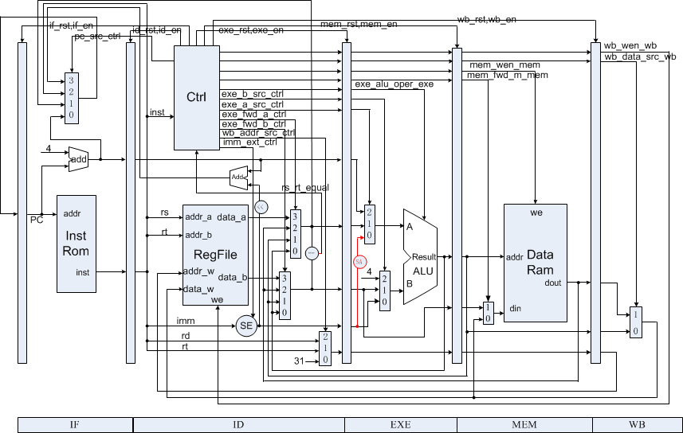
Datapath of CPU supporting 31 MIPS Instr.

Slide 10
signed and unsigned type
reg and wire are unsigned type in Default
Signed Type:
reg signed
wire signed
Type Conversion Function
$signed()
$unsiged()

Slide 11
ALU
case (oper)
EXE_ALU_SLT: begin
if (sign)
result = $signed(a) < $signed(b);
else
result = ……
EXE_ALU_LUI: begin
result = ……
end
……
EXE_ALU_SR: begin
if (sign)
……
else
……
endcase

Slide 12
Instr. Mem.(1)
0 : 3c010000; % (00) main: lui $1, 0 # address of data[0] %
1 : 34240050; % (04) ori $4, $1, 80 # address of data[0] %
2 : 0c00001b; % (08) call: jal sum # call function %
3 : 20050004; % (0c) dslot1: addi $5, $0, 4 # counter,DELYED SLOT(DS) %
4 : ac820000; % (10) return: sw $2, 0($4) # store result %
5 : 8c890000; % (14) lw $9, 0($4) # check sw %
6 : 01244022; % (18) sub $8, $9, $4 # sub: $8 <- $9 - $4 %
7 : 20050003; % (1c) addi $5, $0, 3 # counter %
8 : 20a5ffff; % (20) loop2: addi $5, $5, -1 # counter - 1 %
9 : 34a8ffff; % (24) ori $8, $5, 0xffff # zero-extend: 0000ffff %
A : 39085555; % (28) xori $8, $8, 0x5555 # zero-extend: 0000aaaa %
B : 2009ffff; % (2c) addi $9, $0, -1 # sign-extend: ffffffff %

Slide 13
Instr. Mem.(2)
C : 312affff; % (30) andi $10, $9, 0xffff # zero-extend: 0000ffff %
D : 01493025; % (34) or $6, $10, $9 # or: ffffffff %
E : 01494026; % (38) xor $8, $10, $9 # xor: ffff0000 %
F : 01463824; % (3c) and $7, $10, $6 # and: 0000ffff %
10 : 10a00003; % (40) beq $5, $0, shift # if $5 = 0, goto shift %
11 : 00000000; % (44) dslot2: nop # DS %
12 : 08000008; % (48) j loop2 # jump loop2 %
13 : 00000000; % (4c) dslot3: nop # DS %
14 : 2005ffff; % (50) shift: addi $5, $0, -1 # $5 = ffffffff %
15 : 000543c0; % (54) sll $8, $5, 15 # <<15 = ffff8000 %
16 : 00084400; % (58) sll $8, $8, 16 # <<16 = 80000000 %
17 : 00084403; % (5c) sra $8, $8, 16 # >>16 = ffff8000 (arith) %

Slide 14
Instr. Mem.(3)
18 : 000843c2; % (60) srl $8, $8, 15 # >>15 = 0001ffff (logic) %
19 : 08000019; % (64) finish: j finish # dead loop %
1A : 00000000; % (68) dslot4: nop # DS %
1B : 00004020; % (6c) sum: add $8, $0, $0 # sum function entry %
1C : 8c890000; % (70) loop: lw $9, 0($4) # load data %
1D : 01094020; % (74) add $8, $8, $9 # sum, PIPELINE STALLS %
1E : 20a5ffff; % (78) addi $5, $5, -1 # counter - 1 %
1F : 14a0fffc; % (7c) bne $5, $0, loop # finish? %
20 : 20840004; % (80) dslot5: addi $4, $4, 4 # address + 4, DS %
21 : 03e00008; % (84) jr $ra # return %
22 : 00081000; % (88) dslot6: sll $2, $8, 0 # move result to $v0, DS %

Slide 15
Data Mem.
0 : BF800000; % 1 01111111 00..0 fp -1 %
14 : 000000A3; % (50) data[0] %
15 : 00000027; % (54) data[1] %
16 : 00000079; % (58) data[2] %
17 : 00000115; % (5C) data[3] %

Slide 16
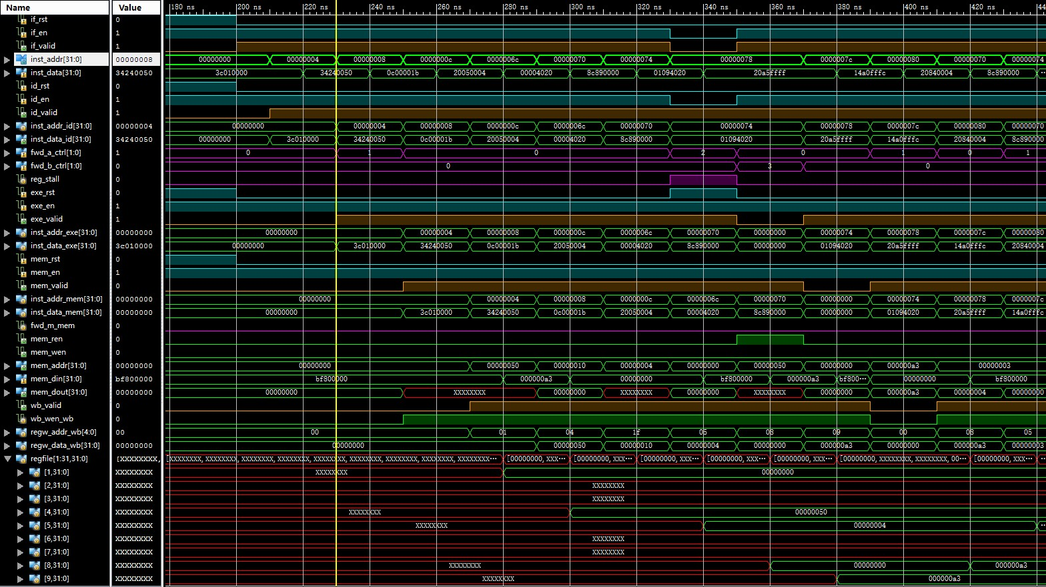
Simulation (1)

Slide 17
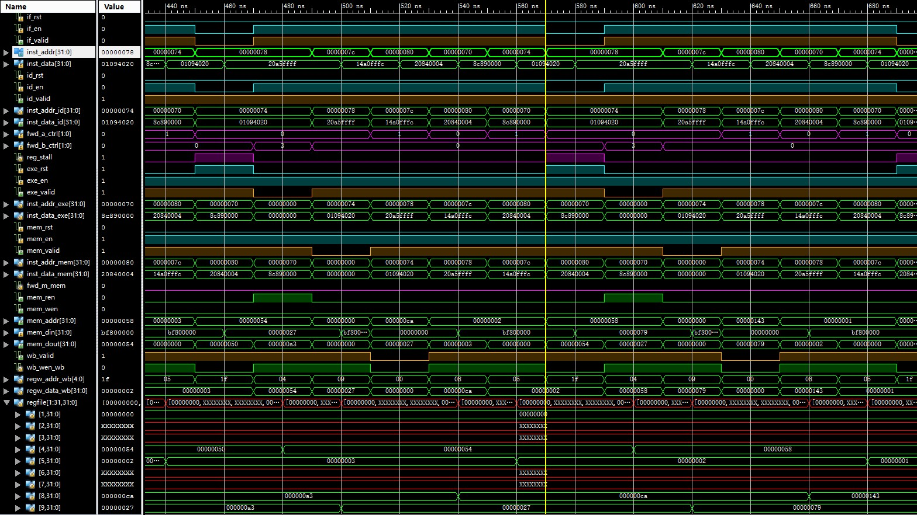
Simulation (2)

Slide 18
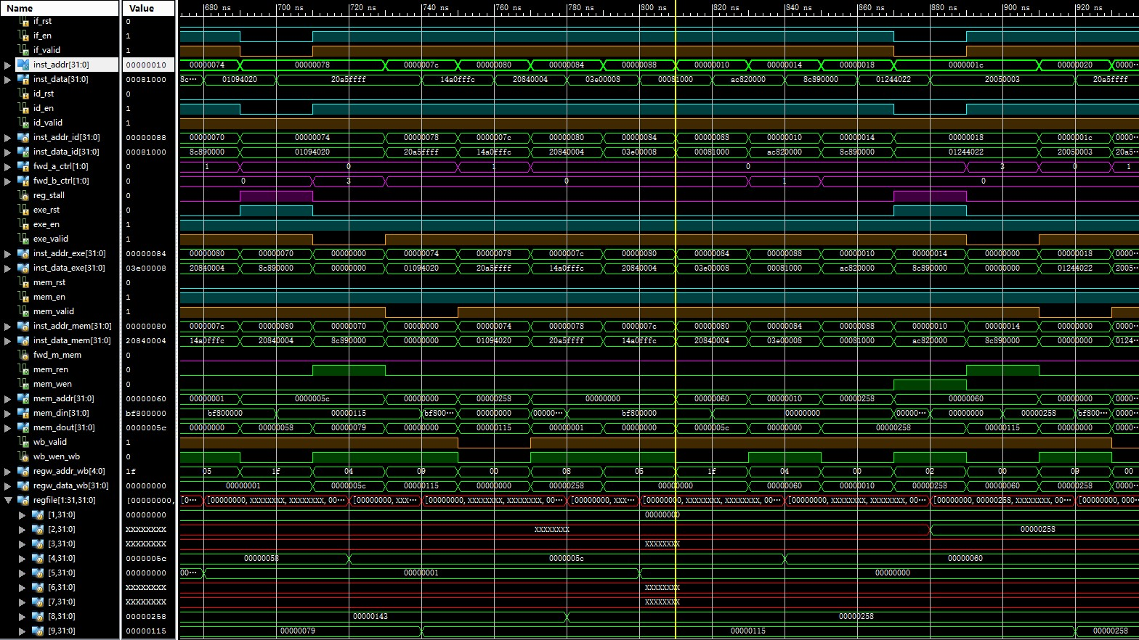
Simulation (3)

Slide 19
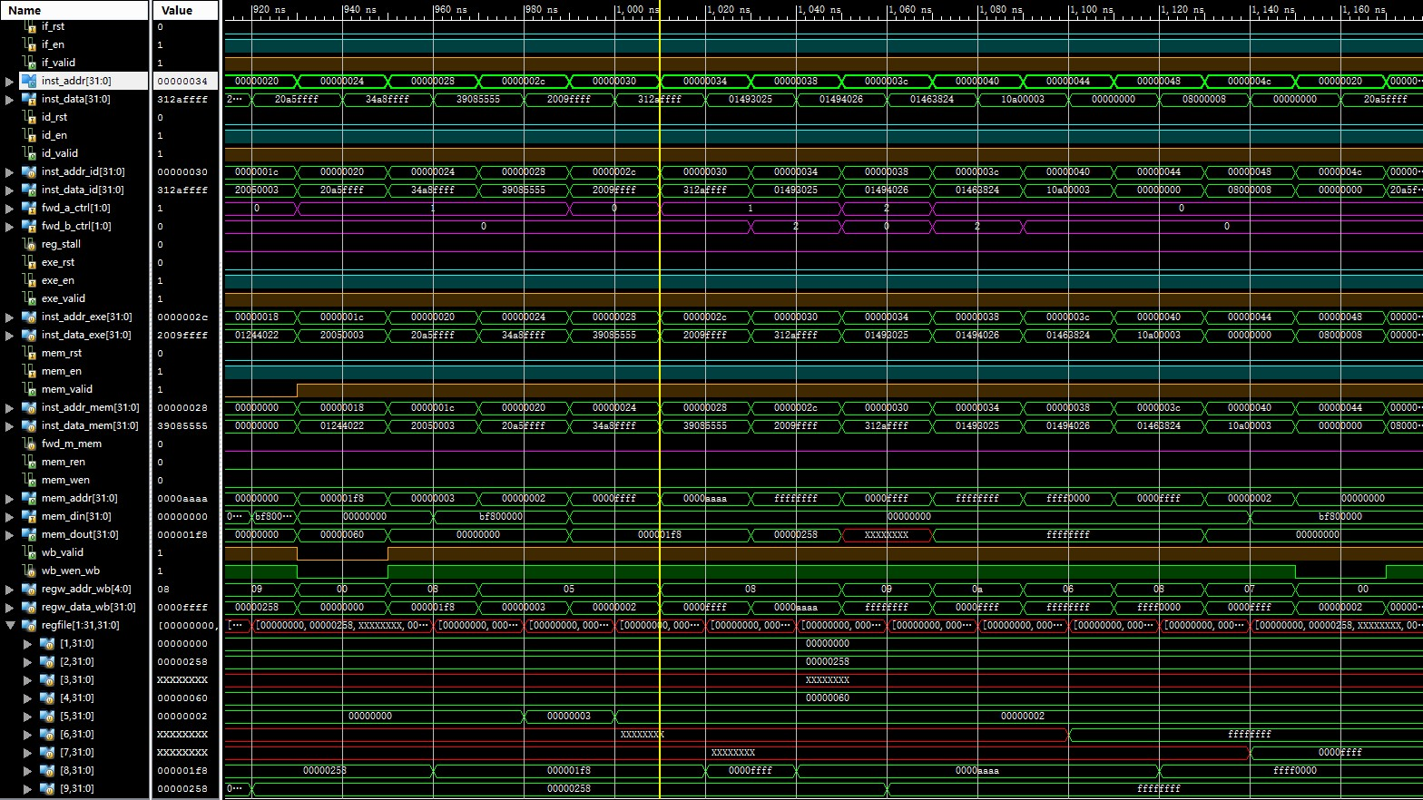
Simulation (4)

Slide 20
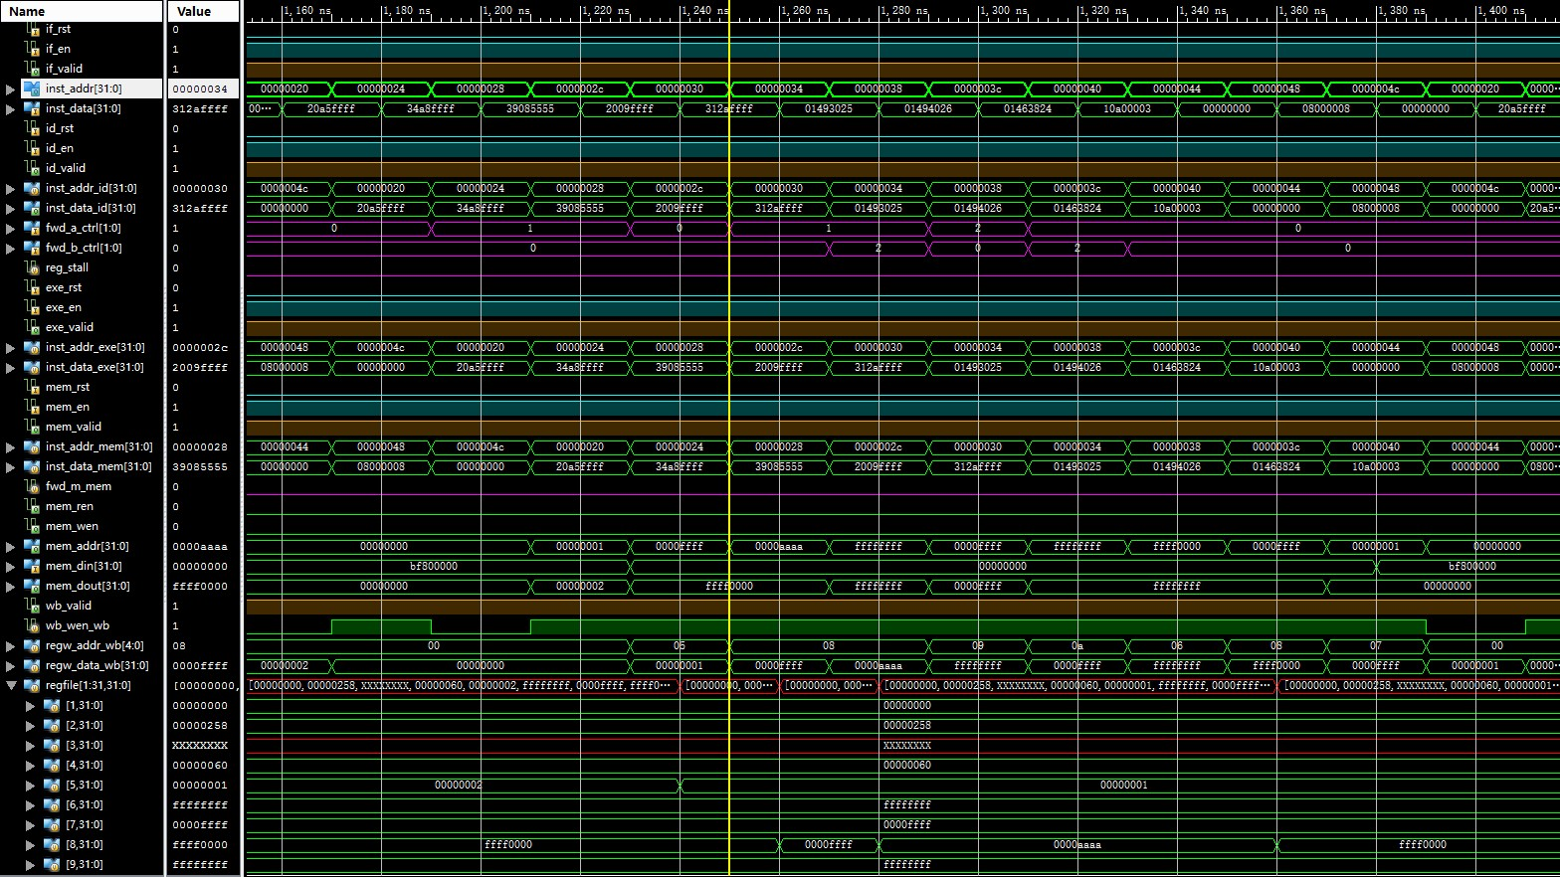
Simulation (5)

Slide 21

Simulation (6)

Slide 22
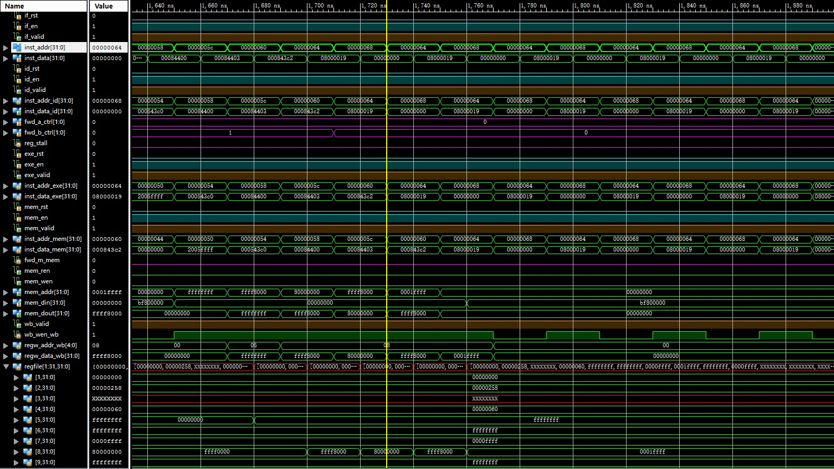
Simulation (7)

Slide 23
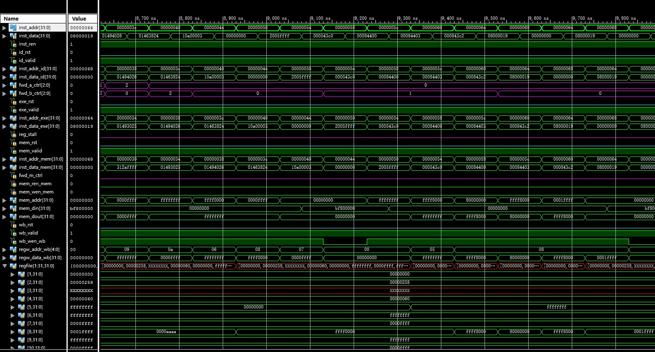
Simulation (8)

Slide 24
Checkpoints
CP 1:
Waveform Simulation of the Pipelined CPU with the verification program
CP 2:
FPGA Implementation of the Pipelined CPU with the verification program

Slide 25
Thanks!

